Slide 1
PVT / eFACTS

Slide 2


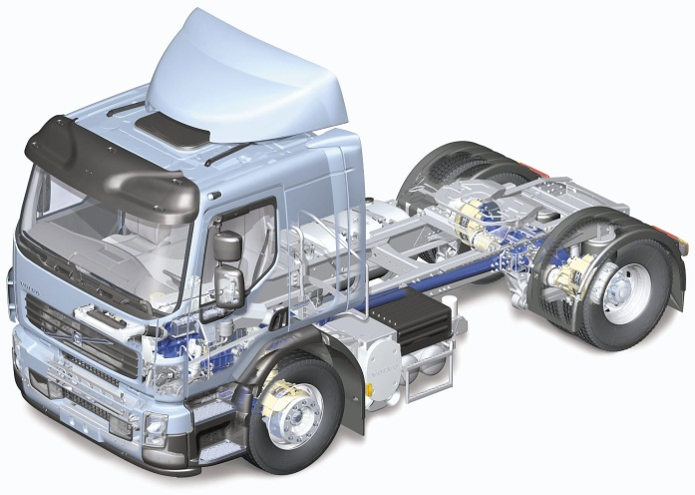

Challange
How to detect and collect the correct error information needed.
How to distribute the information to the correct problem owners.
How to dramatically decrease the leadtime from detected error to delivered report.
Problem/Component
Owners
Error Information
Package
REPORT
ATTACHED DATA FROM EFACTS

Slide 3

PVT – Performance Validation Test
Verification and validation of electrical functionallity in complete vehicles
Function Status
Logged Data
Audio
Video
...
PROTUS
REPORTS
PVT Data Management
PVT TEST CODE
DATA
PACKAGE
DATA ANALYSIS
TOOLS
PVT
REPORTS

Slide 4

E-FACTS
Main Actors
PVT Administration
Users
Users
Test Leaders
Master Editor
Site Editors
Test Leaders
Guest Users
Production Environment 1
Applications
Production Environment 2
Manual Collector
Data Refiner
Synch Tool*
Test Environment 1
Applications
PVT Manager
Report Generator
PVT DATABASE
(ORACLE)
PVT DATABASE
(ORACLE)
PVT DATABASE
(ORACLE)
SERVICES
FOR DATA AND
INFORMATION
HANDLING
Remote Actors
SERVICES
FOR DATA AND
INFORMATION
HANDLING
End Users
SERVICES
FOR DATA AND
INFORMATION
HANDLING
Applications
APP. SERVER
+ DATA STORAGE
Users
E-FACTS
PVT AutomatedTests*
RDM*
APP. SERVER
+ DATA STORAGE
EEE Customers
Users of processed data
APP. SERVER
+ DATA STORAGE
Applications
WEB Search Tool
PVT External Data
* Under development

Slide 5
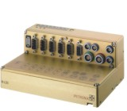


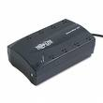





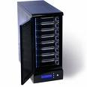

eFACTS
In Vehicle
Logger System
Data Transfer Via USB,
Ethernet, WLAN or 3G.
Volvo IT
Oracle DataBase
Key/Meta Data
Local Data Collector
Raw Data
Automated Upload
Application Server
WEB Search App.
System Service
Converter Service
Data Refiner App.
Adding search keys and comments
Test Administrator
Search Parameters
Mass Storage
(Net Disc)
End Users
Data. (CANalyzer format)

Slide 6


eFACTS
Remote
VCS
RDM
FTP
WCF
FTP/MQ
Collector Application
External Locations
Ex. Sefety data
Application Server
Data Management Services
Converter Service
External Services
WEB Search App.
System Services
REPORT
Oracle DataBase
Key/Meta Data
LINK TO eFACTS DATA
Mass Storage
(Net Disc)

